Slide 1
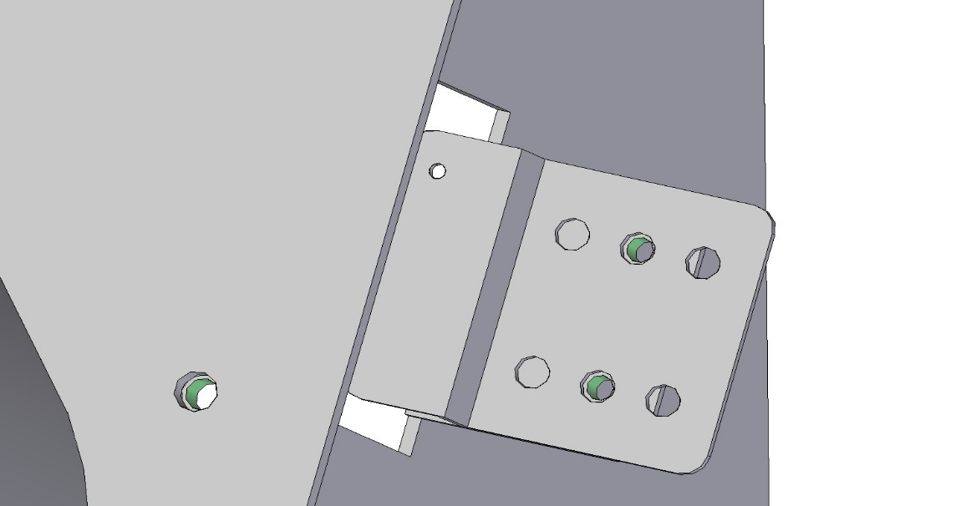
POLAR SLIDE
Adjustment of the hopper spring tension
For adjusting the tension of the hopper spring using this bracket, ensure it is fixed in the bracket center holes. If it is not, adjust the tension by fixing the screws in the center holes.

